Slide 1
DNS on Chord
Anupam Samanta, Jatin Garg, Soumyadeep Chakraborty

Slide 2
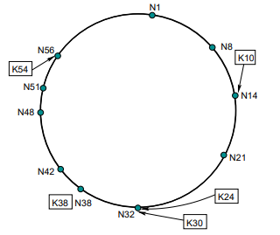
Chord overview

Slide 3
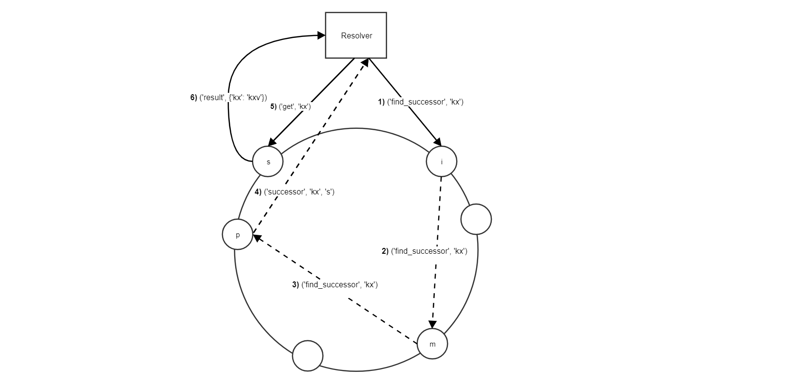
Query resolution

Slide 4
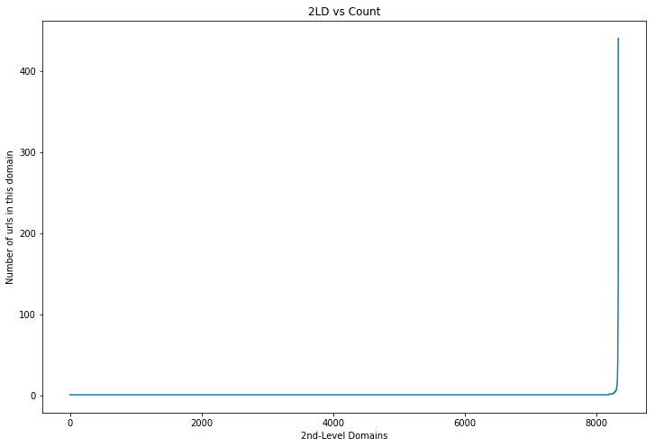
Dataset
10000 (name,ip’s) randomly sampled from rapid7 DNS AAAA records dataset
It has 8328 2nd level domains which follows a zipfian distribution

Slide 5
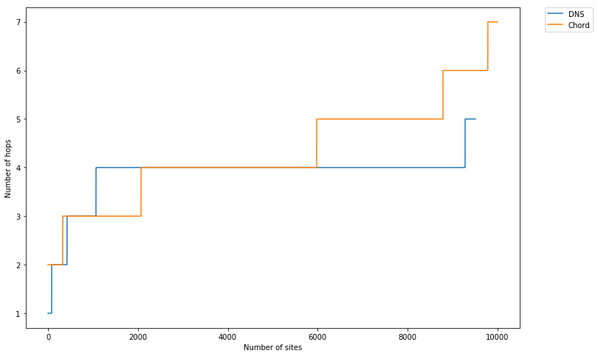
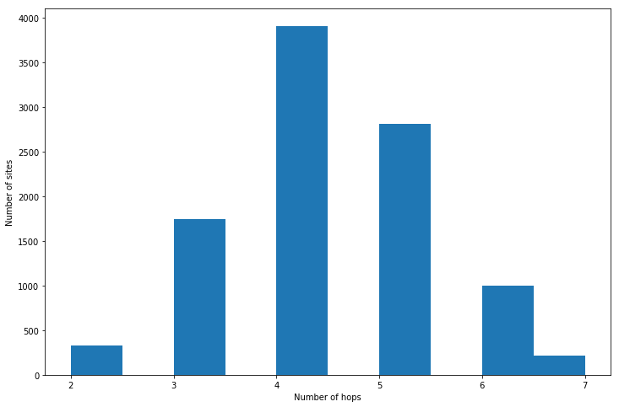
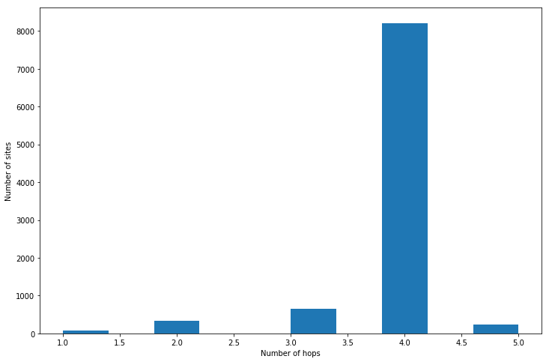
Hop count
Number of Hops: Chords vs DNS
Number of hops: Chord
 | DNS | Chord
Mean | 3.86 | 4.30
Median | 4.00 | 4.00
Std. dev. | 0.54 | 1.04
Min | 1.00 | 2.00
Max | 5.00 | 7.00
Number of hops: DNS
Notes:
Here we are measuring the number of hops a DNS or Chord has to made to resolve all addresses. We can see that the number of hops are more in that of a chord implementation by around 0.5 on an average.
Number of hops statistics: Mean: 4.30 Var: 1.04 Median: 4.00 Max: 7.00 Min: 2.00
Number of hops statistics: Mean: 3.86 Var: 0.54 Median: 4.00 Max: 5.00 Min: 1.00

Slide 6
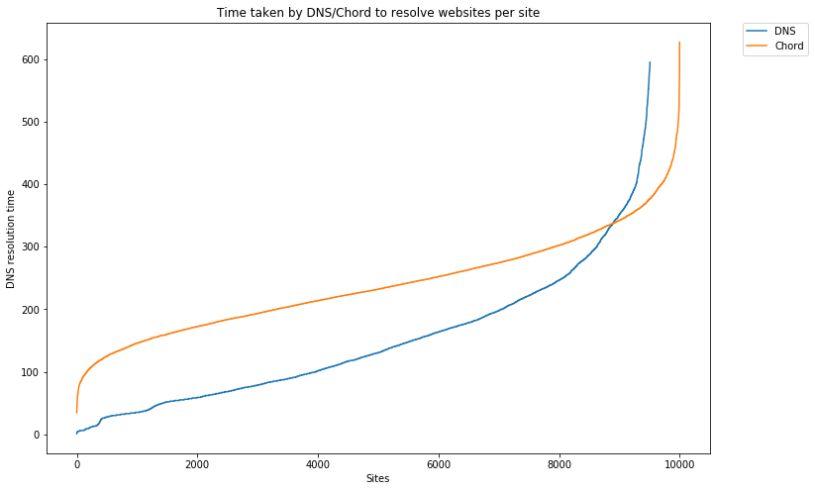
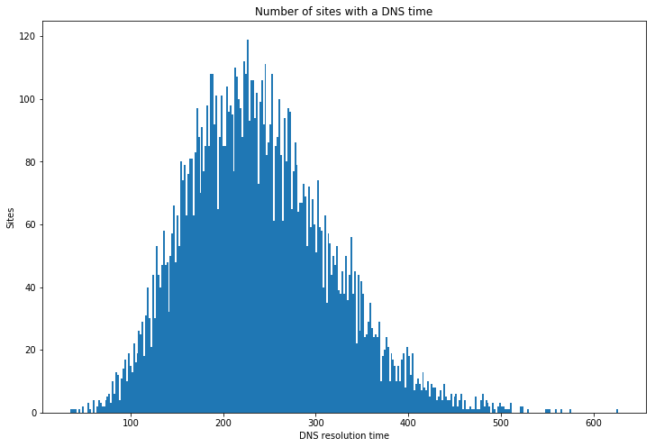
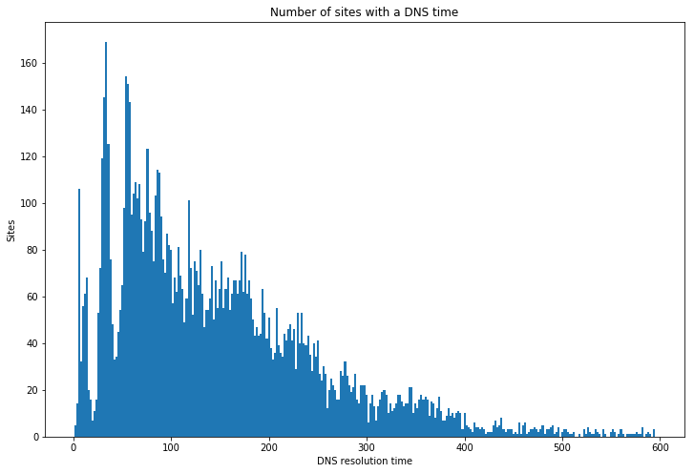
Performance Analysis
DNS/Chord resolution time comparision
Chord resolution time histogram
 | DNS | Chord
Mean | 147 ms | 239 ms
Median | 124 ms | 232 ms
Std. dev. | 104 ms | 77 ms
Min | 1 ms | 34 ms
Max | 595 ms | 627 ms
DNS resolution time histogram
Notes:
When we compare the performance between the traditional DNS (8.8.4.4) and our implementation, we observe that the mean and median of the resolution time is higher by 100 ms for chord. This can be attributed to the fact that the number of network calls grows logarithmically in Chord with the number of servers as opposed to being relatively constant in traditional DNS.
We also see that the traditional DNS resolution time’s follow a multimodal distribution. We modeled a kernel density estimator to simulate this distribution and introduce real world network latency in our chord.

Slide 7
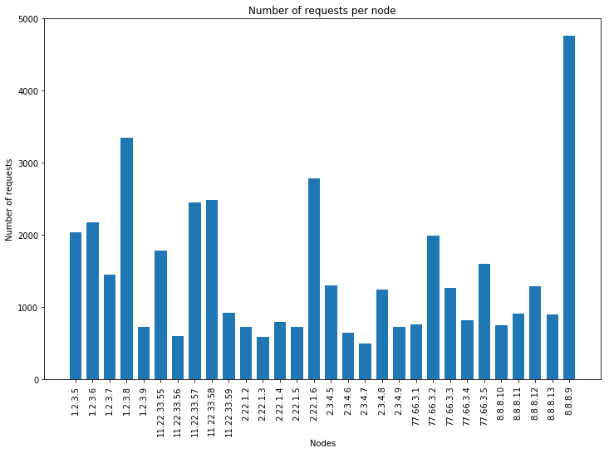
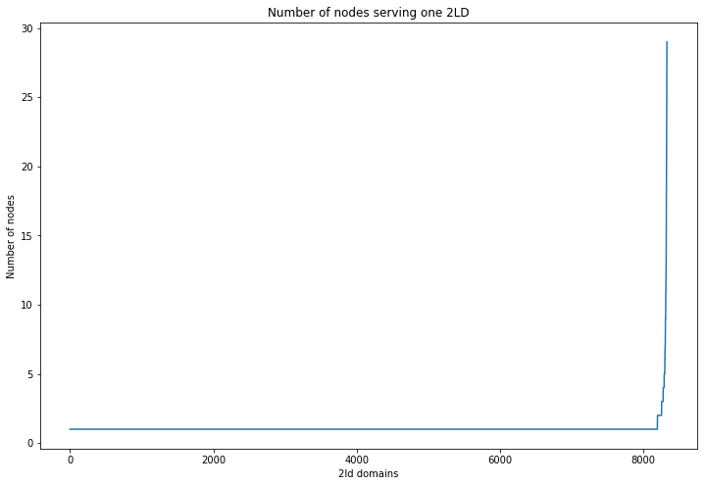
Node load distribution
Notes:
As we can see here, the graph shows the number of requests in which each node took part either as being the final or an intermediate node in the query process. Chord allows a more smoother distribution of workload among all nodes because of absence of namespace hierarchy. Whereas in a traditional setting, almost all of the requests have to pass through the first 2 hops towards the root of the hierarchy.
The next plot shows the distribution of URL’s of a DNS zone each node, where we can see that DNS zones that have more URL’s are distributed among more nodes eliminating single point of failure that is found in traditional setting.

Slide 8
Thank You

